Slide 1
Parental Involvement in Educational Planning
Carrizo Springs CISD Special Education Department:
Brea Horton, Special Education Secretary
Linda Estrada, M. Ed., Educational Diagnostician
Angelica Doak, CSCISD Special Education Director

Slide 2

What is Parental Involvement?
Reading with your child
Helping with homework
Discussing school day/events
Attending school functions
School volunteer
Involvement is the first step to engagement.
Notes:
NOTE: To change images on this slide, select a picture and delete it. Then click the Insert Picture icon in the placeholder to insert your own image.

Slide 3

What is Parental Engagement?
Schools empower parents and caregivers by providing ways to actively participate
Schools promote them as important voices in the school
Schools remove barriers to engagement
With engagement, home and school come together as a team.
Notes:
NOTE: To change images on this slide, select a picture and delete it. Then click the Insert Picture icon in the placeholder to insert your own image.

Slide 4
Why is it important to involve parents in school?
Children whose families are engaged in their education are more likely to:
Earn higher grades and score higher on tests
Graduate from high school and college
Develop self-confidence and motivation in the classroom
Have better social skills and classroom behavior

Slide 5
How can parents get involved in their child’s education?
Make learning a priority in your home.
Read to and with your children.
Communicate with their teachers.
Attend school events.
Use your commute to connect with your kids.
Eat meals together.
Communicate with the school and/or school district.

Slide 6



Parent Participation in Special Education is a priority under federal law.
Notes:
NOTE: To change images on this slide, select a picture and delete it. Then click the Insert Picture icon in the placeholder to insert your own image.

Slide 7

What is an IEP?
An IEP is a written statement of the educational program designed to meet a child’s individual needs.
Purpose:
To set reasonable goals for a child
To state the services that the school district will provide the child

Slide 8
Who? What? When?
Who develops the IEP?
Team of individuals: school staff and the child’s parents
What’s in an IEP?
Specific information: Present levels of academic achievement and functional performance, goals, special education and related services
When is the IEP developed?
IEP meeting must be held 30 calendar days after it is determined, through a full and individual evaluation, that a child has a disability and needs special education and related services. A child’s IEP must also be reviewed annually to determine whether the annual goals are being achieved and must be revised as appropriate.

Slide 9

Can students be involved in developing their own IEPs?
The Individuals with Disabilities Education Act (IDEA) actually requires that the student be invited to any IEP meeting where transition services will be discussed.

Slide 10
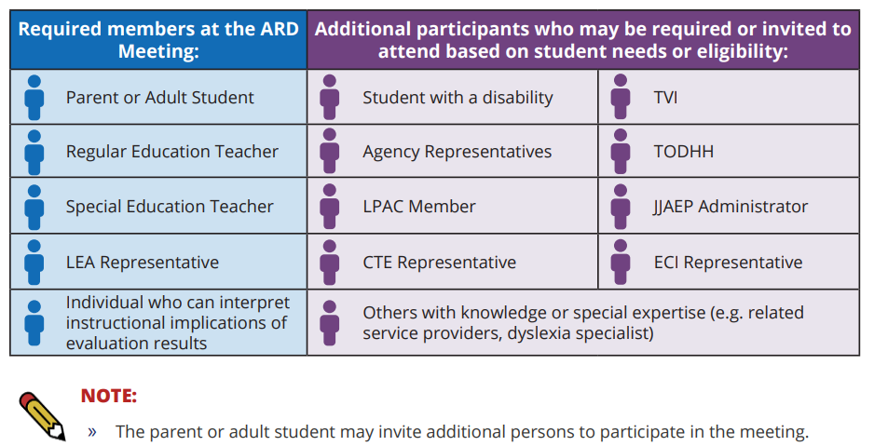

Slide 11
What to expect at the Individualized Education Program Meeting?
https://start.successed.net/content/BlankForms/IEPSheet.pdf

Slide 12


Resources
Carrizo Springs CISD
Texas Education Agency

Slide 13
References
“Free Appropriate Public Education (FAPE)| Special Education Law Essentials.” Think Spectrum. October 6, 2021. https://www.youtube.com/watch?v=si5t8vmsNHk
“Parent Participation in Special Education Process is a Priority Under Federal Law.” PAVE. retrieved on July 15,2024. https://wapave.org/parent-participation-in-special-education-process-is-a-priority-under-federal-law/
“Parental Involvement In Your Child’s Education.” The Annie E. Casey Foundation. December 14, 2022. https://www.aecf.org/blog/parental-involvement-is-key-to-student-success-research-shows
“Special Education 101: IEP.” Navigate Life Texas. https://www.navigatelifetexas.org/en/videos/video/special-education-101-iep
Texas Education Agency. (2023, June). Technical Assistance:Individualized Education Program (IEP) Development. Retrieved from https://tea.texas.gov/academics/special-student-populations/special-education/iep-development.pdf
“The Short and Sweet IEP Overview.” Center for Parent Information and Resources. April, 2022. https://www.parentcenterhub.org/iep-overview/

Slide 14
Questions?

