Slide 1


Advantages and Challenges of Technology for the Blind
Exploring Innovations and Overcoming Barriers
Presented by: Harry Staley

Slide 2
About Me:
Professional Life:
Senior Software Engineer / Senior Data Scientist @ M1 Technology
ISC2 Certified Information Systems Security Professional (CISSP)
B.S. Computer Science from TAMUSA
Graduate Student at Georgia Institute of Technology
Worked on projects focusing on Big Data, security research, Mesh networked Virtual Private Networks (VPN), etc.

Slide 3
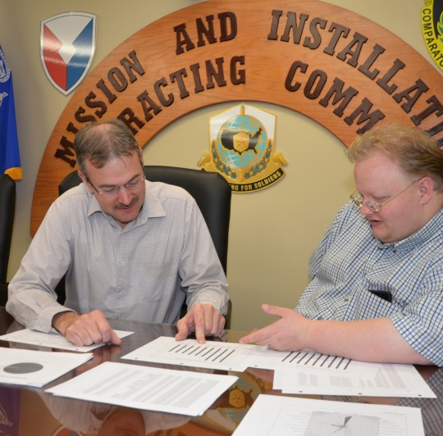
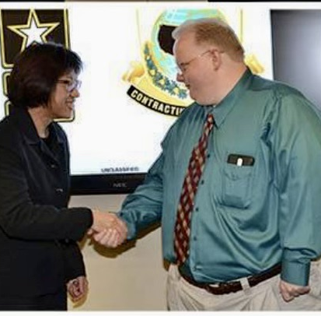

16 Years in Tech 11-year in U.S. Army Civilian Service
z

Slide 4

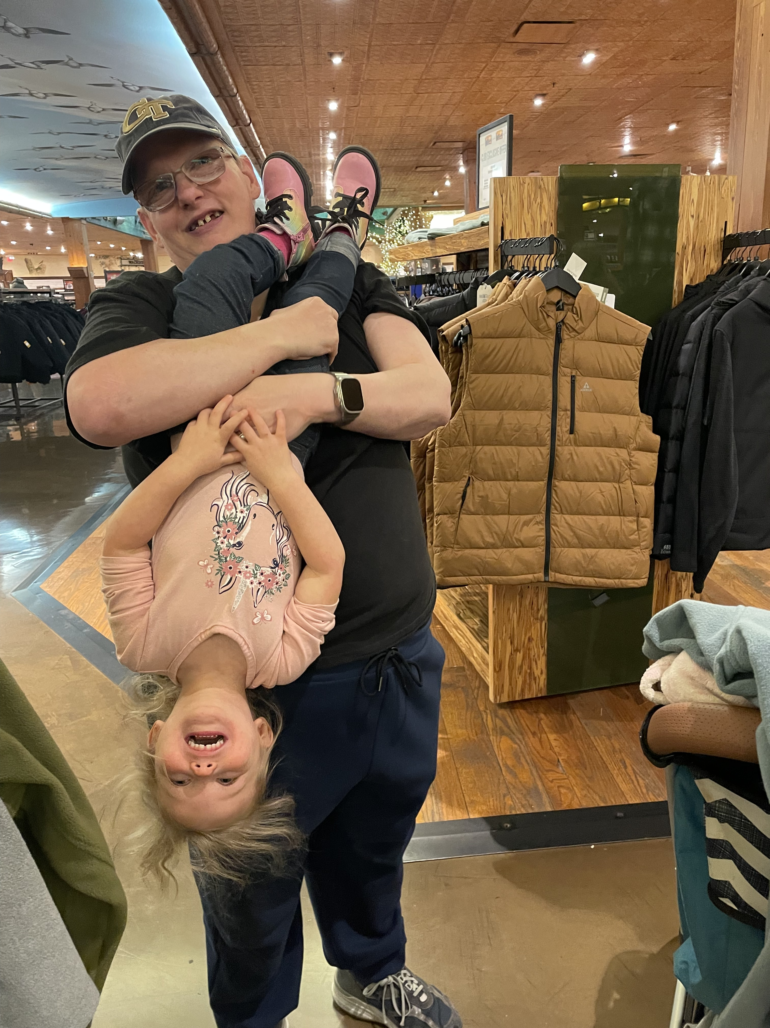
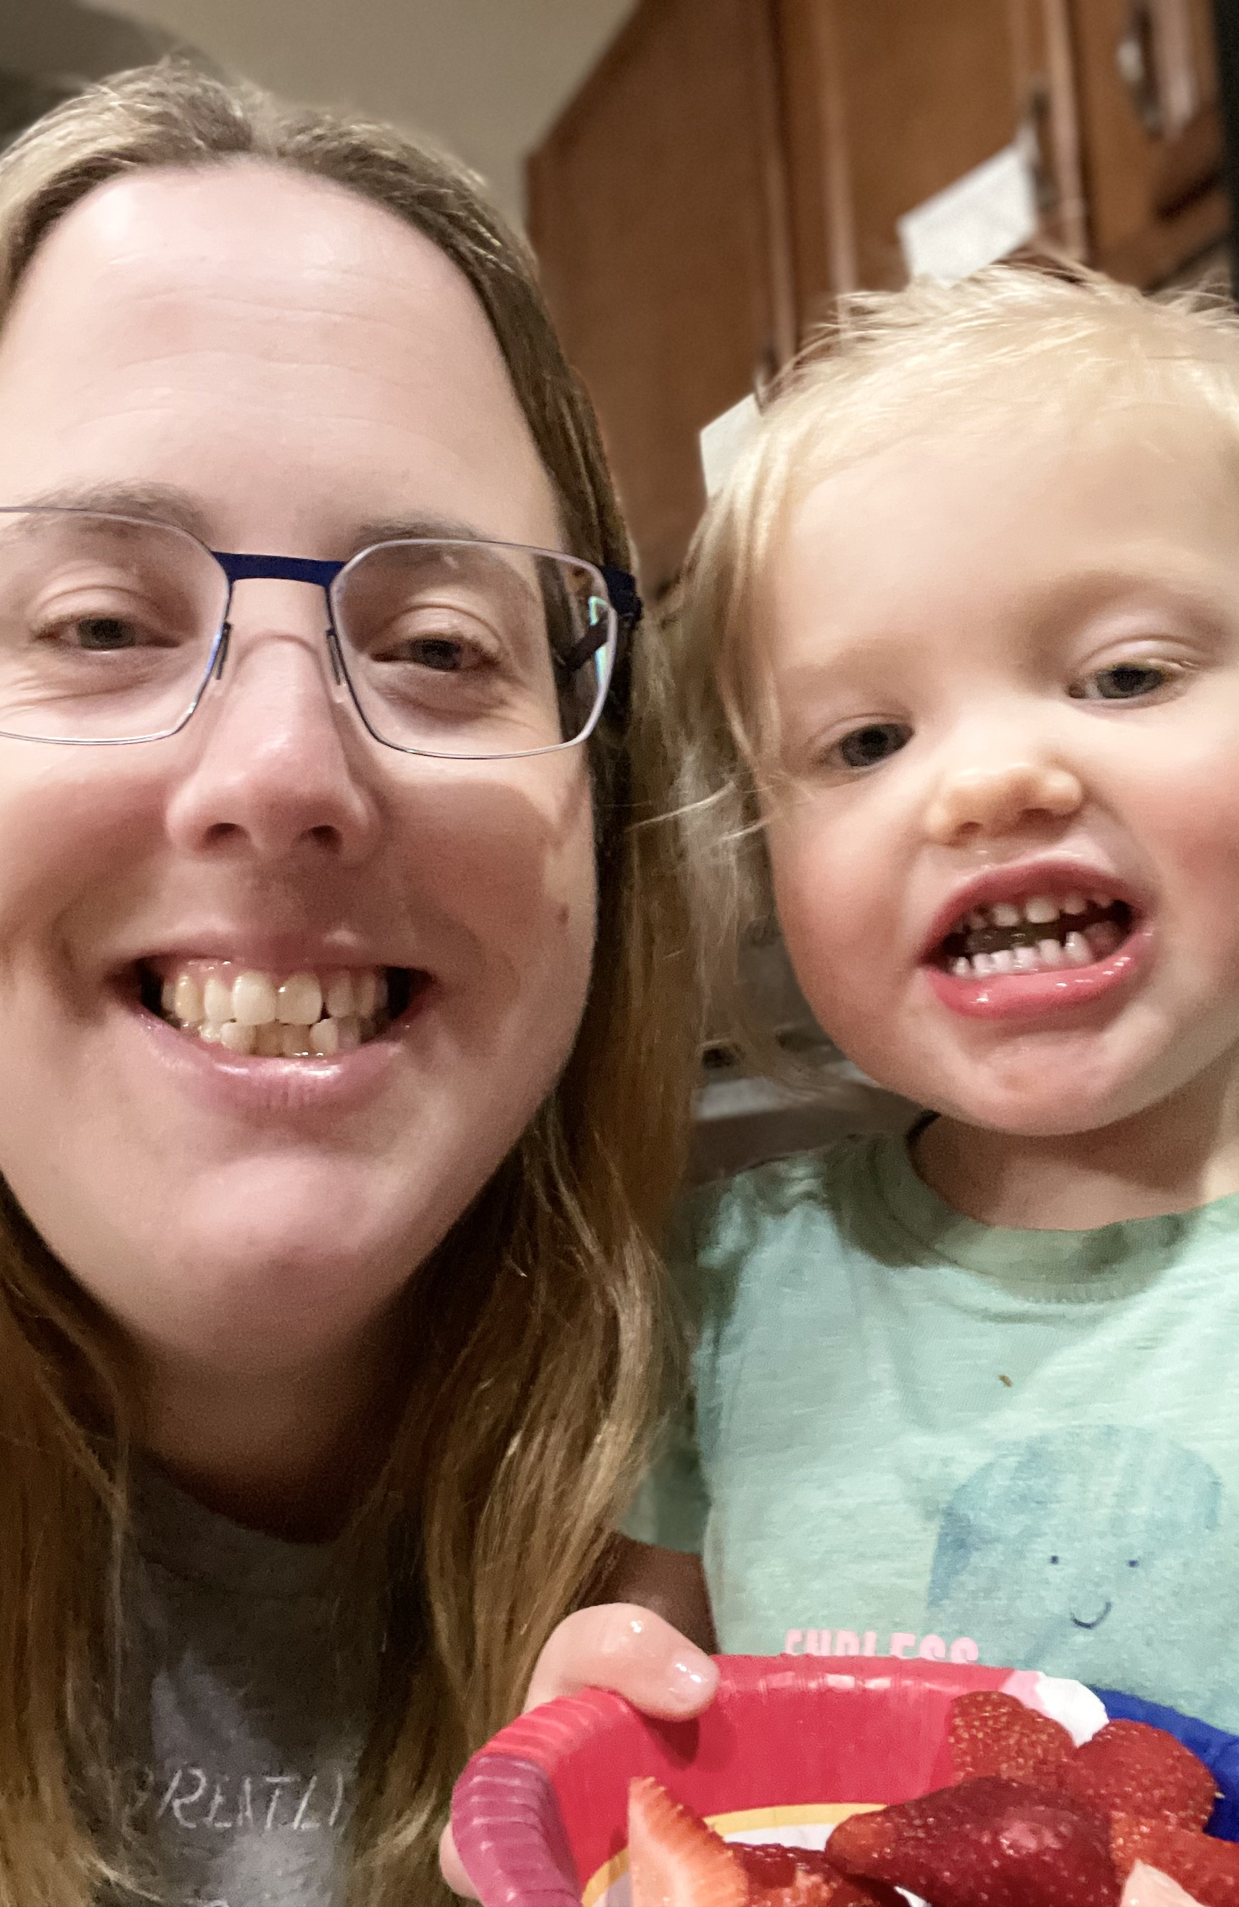
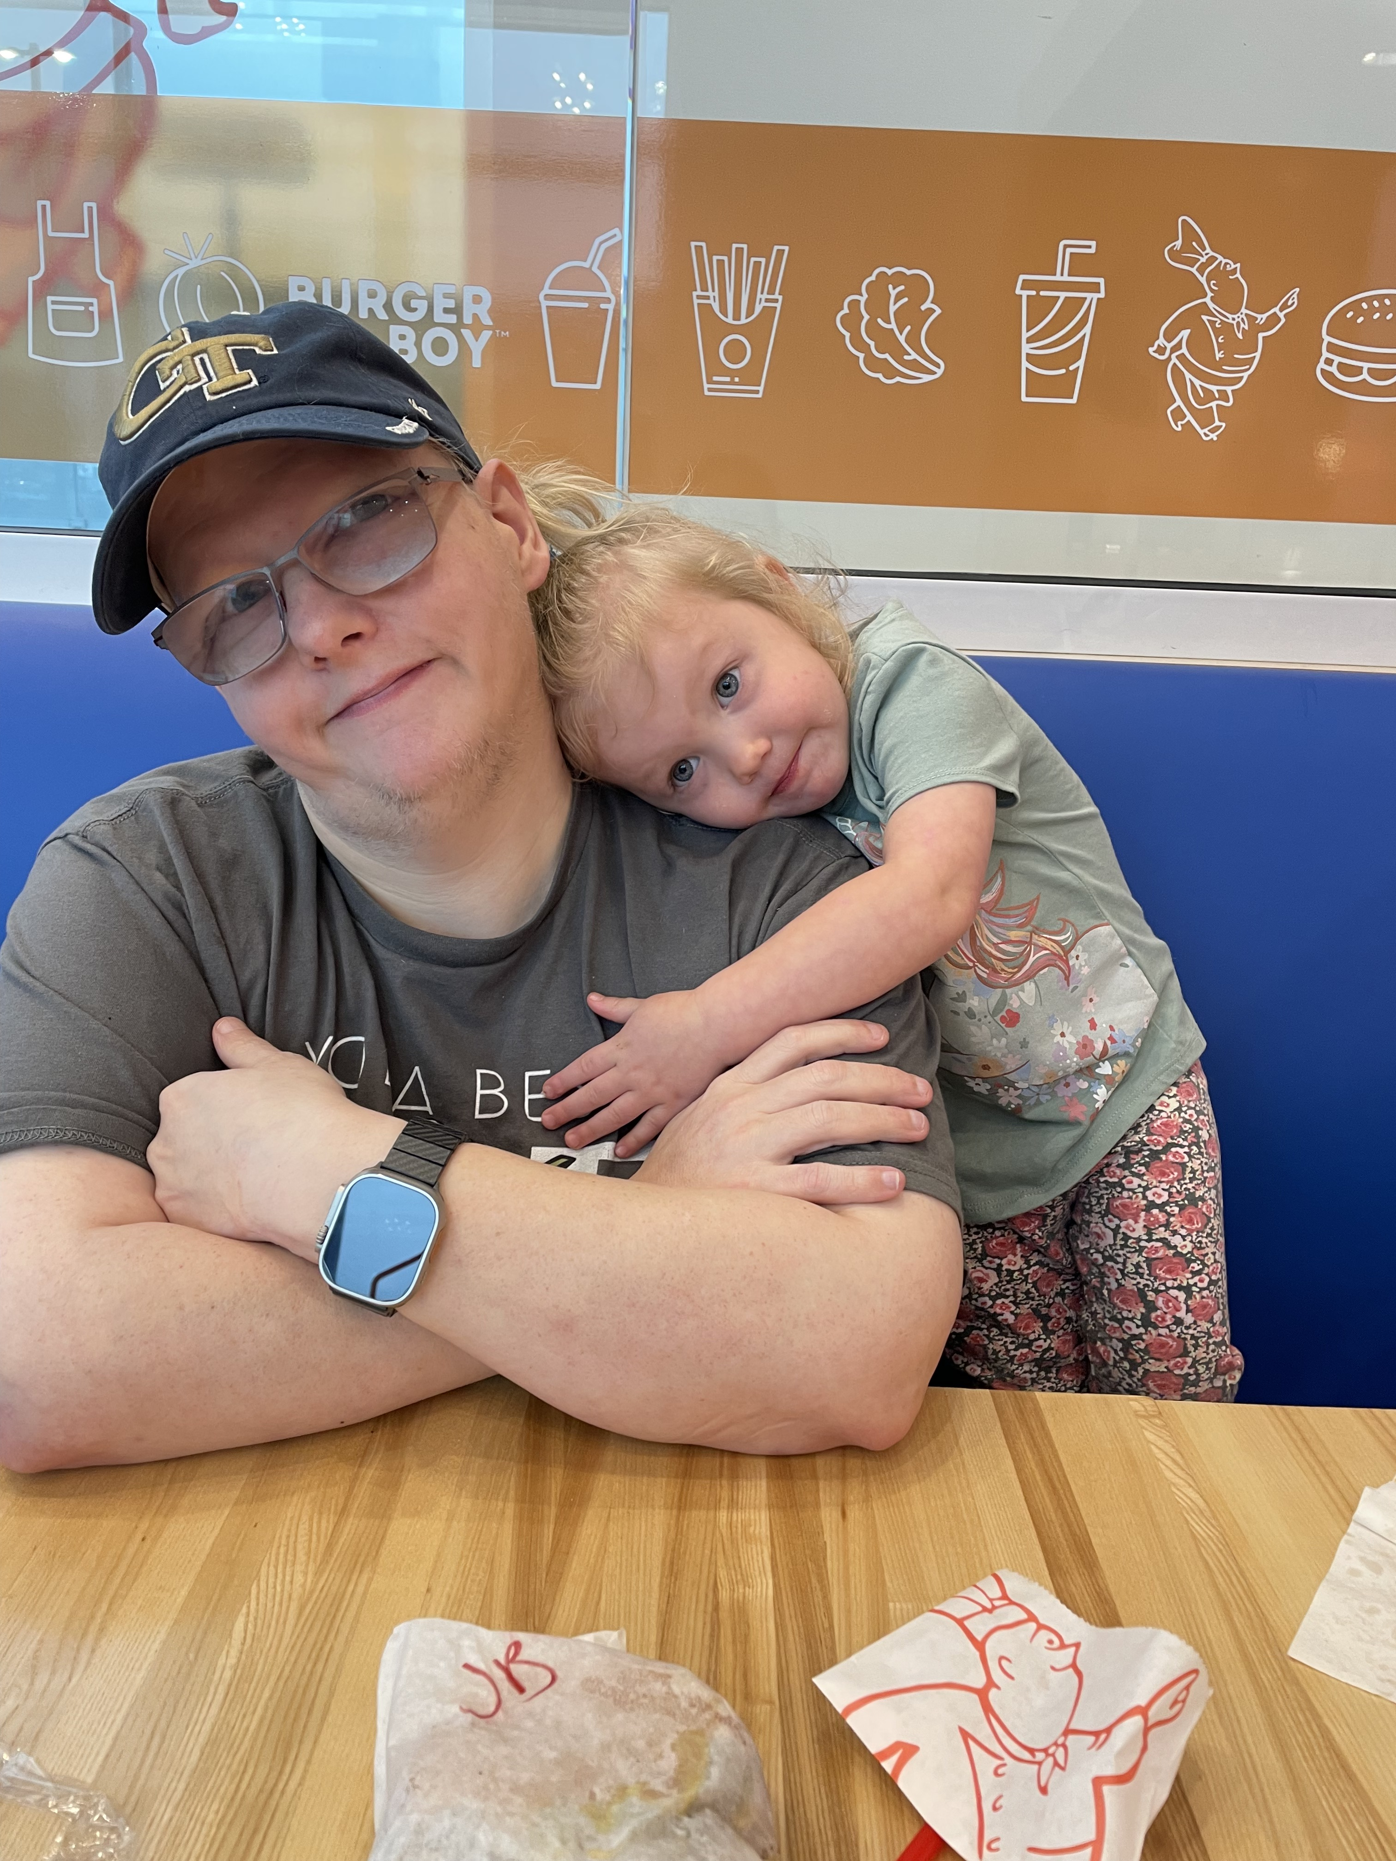
Personal Life
z

Slide 5
High Tech Resources
Screen readers: JAWS, NVDA, ORCA
Braille displays:
Audio books: Audible and Learning Ally
Mobile Applications:
Navigation and mobility apps: Seeing AI, Be My Eyes, Blind Square, Way Around, etc.
Educational and recreational: Voice Dream Reader and BrailleTouch
Wearable Technology:
Smart glasses: Devices like Aira and OrCam provide visual information through audio feedback.
Tactile feedback devices: Devices that convert visual information into tactile feedback, enhancing spatial awareness.
AI Tools: Chat GPT, Seeing AI, etc.

Slide 6
Low-Tech Resources
Braille, Tactile Graphics, and Maps:
Benefits: Aid in understanding spatial concepts and geographical locations.
Mobility:
White canes: Simple yet effective tools for mobility and spatial awareness.
Mental mapping, and descriptions can assist with navigation.
Math and Science Tools:
Abacus: can serve as a means to add, subtract, multiply, and divide tactilely.

Slide 7
Challenges
Cost and Accessibility:
Assistive technology can be expensive, limiting access for many.
There is a disparity in availability across different regions, some technologies have limited licensing.
Technical Limitations:
Compatibility issues between different devices and software.
Reliance on a continuous power supply and internet connectivity can be a barrier.
Learning Curve:
Adapting to new technologies requires time and effort.
Adequate training and support are essential for effective use.

Slide 8
Addressing the Challenges
Self Advocacy is Key to Success:
Build Relationships.
Use personal/professional networks.
Be well prepared to discuss your individual capabilities and needs.
Don’t be afraid to fail, but being well prepared, can raise tip the odds in your favor..
Affordability Initiatives:
Government and NGO programs may offer subsidies and funding.
Community support and crowdfunding can also provide financial assistance.
Improving Accessibility:
Developing user-friendly and compatible devices through inclusive design.
Adherence to standards such as W3CAG AA, and AAA, Section 508, etc. help, but are not the same as accessible.
Security and Accessibility are of EQUAL importance, Baked in, NOT bolted on.

Slide 9
Addressing the Challenges (Cont.)
Educational and Support:
Training programs for users and educators help in adapting to new technologies:
Louisiana/Colorado Center for the Blind
Vibrant Works
TWC
Peer networks and resources provide ongoing assistance.
National Federation of the Blind
Ibug
Mentoring!

Slide 10
Success Stories.

Slide 11
Conclusion
Key Takeaways:
Technology offers significant advantages but also presents challenges for the blind.
Both electronic and non-electronic tools play crucial roles in improving accessibility and independence.
Explore new/old technologies, techniques and aids.
Advocate for increased awareness and support for assistive technology and human centered design.

Slide 12
Questions?

